Slide 1

NCWIT micro:bit Workshop
Dr. Carol Spradling
Dr. Denise Case
Saturday, September 21, 2019
9:30 am – 12:30 pm

Slide 2

Today
Workshop 9:30 am to 12:30 pm
Lunch & Networking event 12:30 to 2:30 pm
Start Applications. 2:30 to 4:00 pm

Slide 3
Workshop Schedule
Introductions & Overview (10 minutes)
The micro:bit (10 minutes)
What’s Possible (10 minutes)
Hands On: Unboxing & Setup (10 minutes)
Creating Projects (10 minutes)
Hands On: Animations (10 minutes)
Hands On: Rock, Paper, Scissiors (20 minutes)
Break (10 minutes)
Controlling an Andriod Phone (20 minutes)
Hands On: Remote Selfie (30 minutes)
Testing & Sharing your Apps (20 minutes)
Wrapping Up / Discussion (10 minutes)

Slide 4
Overview (10 min)

Slide 5
Introductions
Dr. Carol Spradling
Dr. Denise Case
Attendees
Where are you from?
What year are you?
What brings you here?

Slide 6
What to Expect
Learn a fun, new technology
Practice a bit of coding
Chance to build something creative
Meet other interested/interesting women
Chance to share your app at the end

Slide 7
The micro:bit (10 min)

Slide 8
What is this thing?
The micro:bit is a pocket-sized computer that you can code, customize and control to bring your digital ideas, games and apps to life. It’s a small, code-able device that is a non-intimidating introduction to programming and making – switch on, program it to do something fun – wear it, customize it, develop new ideas.
The micro:bit platform combines the 'bit, a pocket-sized coding device featuring several sensors and LEDs, with an awesome website full of coding examples and projects. Start out with the video tutorials, then check out the ideas page to get creative. From making your own games to taking selfies, the possibilities are endless!
The micro:bit is based off of the nRF51822 microcontroller, which has built in Bluetooth LE radio. There are two programmable buttons that can be used to control games, send a radio message, activate the display, etc. The micro:bit can detect motion (using an accelerometer) and tell you which direction you are heading in (using a magnetometer/compass chip). On the bottom is an expansion port, with 5 alligator-clip friendly pads and additional card-edge contacts for 19 total I/O pins. Each of these sensors, inputs, and outputs, is completely programmable via easy-to-use software that can be accessed from a PC, laptop, tablet, or mobile. You can use MakeCode/PXT blocks or micro Python to start your programming adventure.
The micro:bit Go Bundle contains:
• BBC micro:bit
• Micro USB cable, 6" end-to-end
• 2 x AAA battery holder
• 2 x AAA battery
See similar devices such as: Circuit Playground, Arduino, Feather, or Raspberry Pi.

Slide 9
The micro:bit

Slide 10
5 x 5 LED Grid
Notes:
5xm x 4cm

Slide 11
Buttons (A & B)
Notes:
Artwork source: http://microbit.org/images/microbit-features-buttons.png

Slide 12
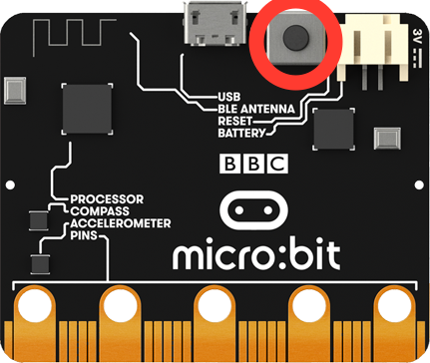
Reset Button (on back)
Notes:
Artwork source: http://microbit.org/images/microbit-features-buttons.png

Slide 13
Connectors
Notes:
Artwork source: http://microbit.org/images/microbit-features-pins.png

Slide 14
Light Sensor
Notes:
Artwork: http://microbit.org/images/microbit-features-light.png

Slide 15
Temperature Sensor
Notes:
Within about 2 degrees C (die temperature)
Artwork source: http://microbit.org/images/microbit-features-temp.png

Slide 16
Accelerometer
measures the forces acting on a tiny weight in each of three dimensions
Notes:
Detect/respond to tilt/tip/shake/etc.
Artwork source: http://microbit.org/images/microbit-features-accelerometer.png

Slide 17
Compass
senses the magnetic field
Notes:
5xm x 4cm
Artwork source:http://microbit.org/images/microbit-features-compass.png

Slide 18
Radio
Send and receive data using radio packets
Notes:
5xm x 4cm
Artwork source: http://microbit.org/images/microbit-features-radio.png

Slide 19
Bluetooth
Low-energy wireless communication between devices
To pair: hold down all 3 buttons
Notes:
Bluetooth: It can talk to mobile devices!!!
Artwork source: http://microbit.org/images/microbit-features-bluetooth.png

Slide 20
Low Cost: ~$13 US Go Bundle: ~$17.50 US (with USB and batteries)
Notes:
Artwork source: http://microbit.org/images/microbit-features-temp.png

Slide 21
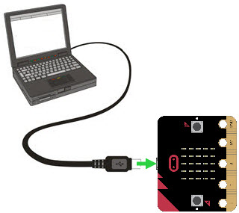
USB Cable
Connects micro:bit to laptop
only fits one way (be careful)
Notes:
Artwork source: http://microbit.org/images/microbit-features-temp.png

Slide 22
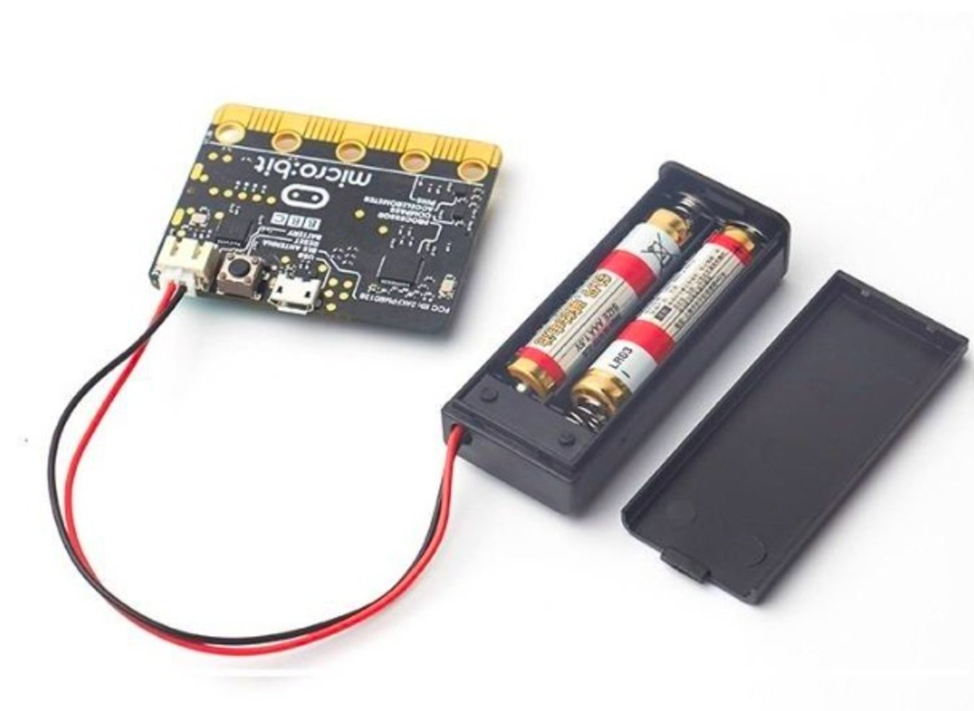
Battery Pack
Powers micro:bit when not connected to laptop
only fits one way (check pins before connecting)
Notes:
Artwork source: http://microbit.org/images/microbit-features-temp.png

Slide 23
What’s Possible (10 min)

Slide 24
Custom Animations and Messages

Slide 25
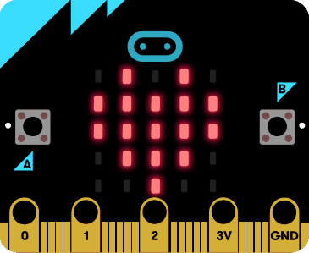
Custom Animations

Slide 26
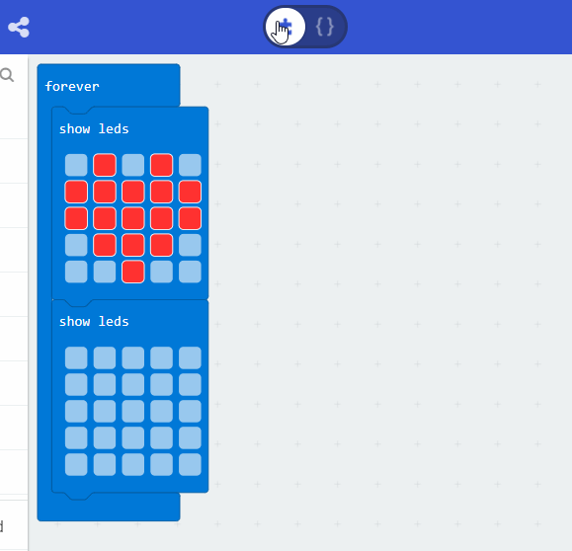
Flashing Heart

Slide 27
Play Games

Slide 28
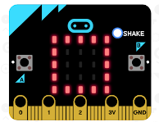
Play Rock, Paper, Scissors
When you shake the micro:bit, it picks a random number from 1 to 3 displays either rock, paper, or scissors

Slide 29
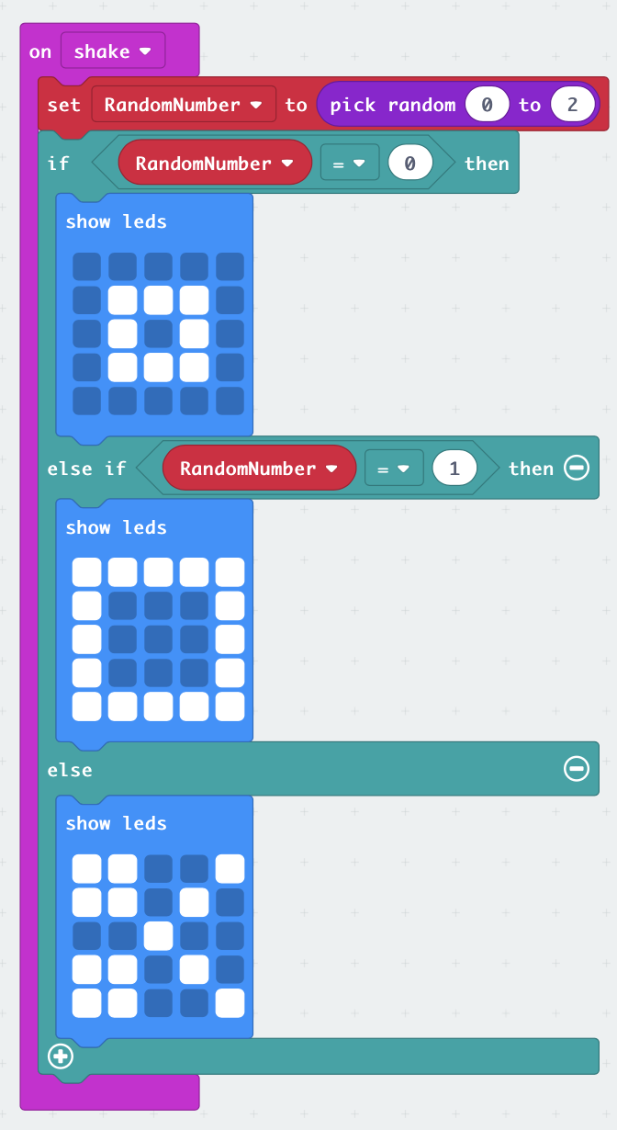

Slide 30
Control Devices Wirelessly

Slide 31
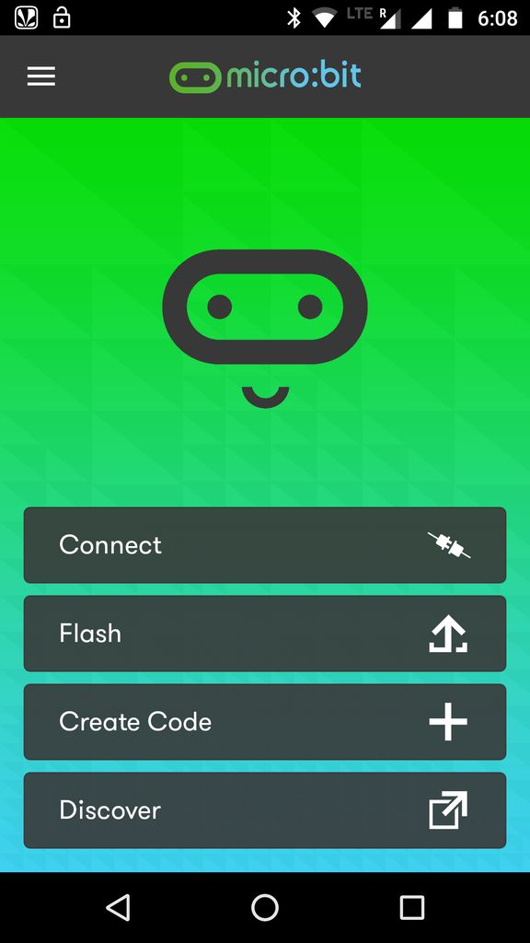
Remote Selfies
https://www.instructables.com/id/Microbit-Selfie-Remote/
Install Android App

Slide 32
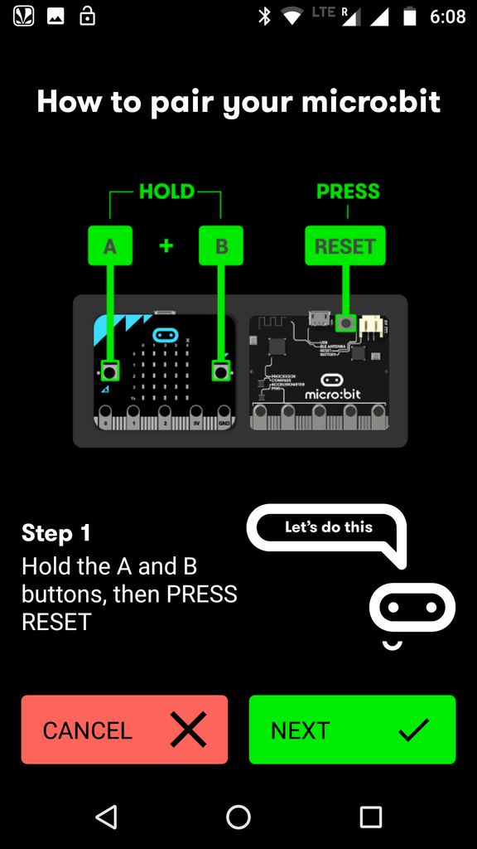
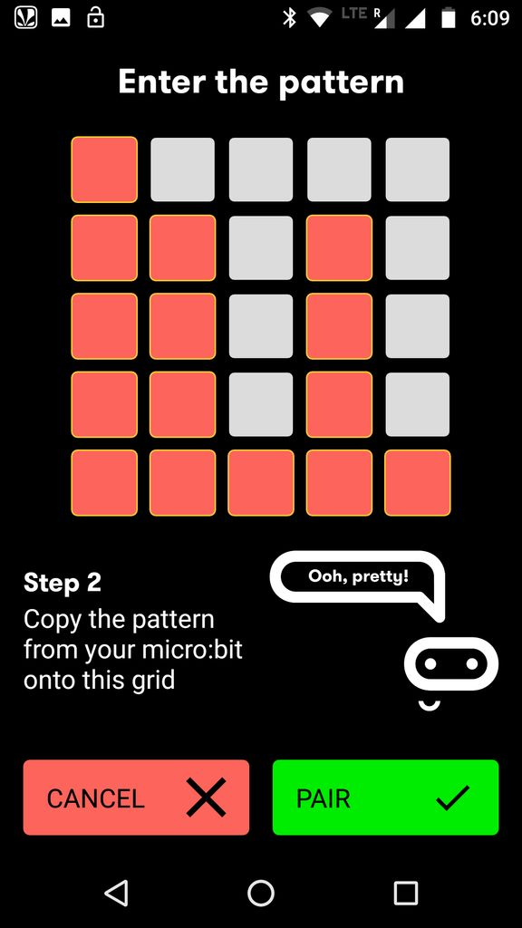
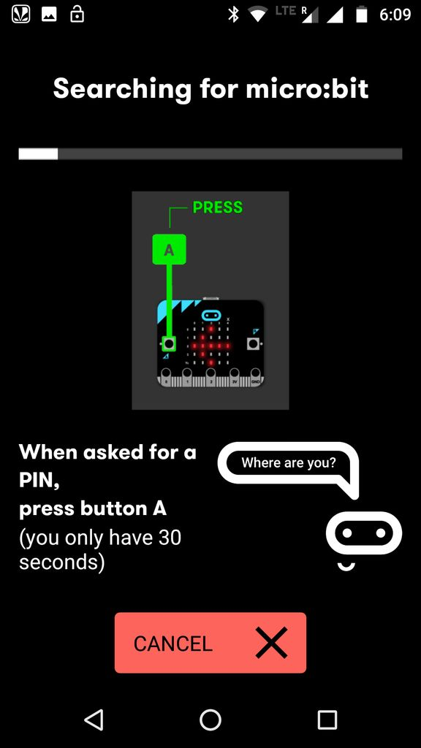
Remote Selfies
https://www.instructables.com/id/Microbit-Selfie-Remote/
Pair micro:bit and phone

Slide 33
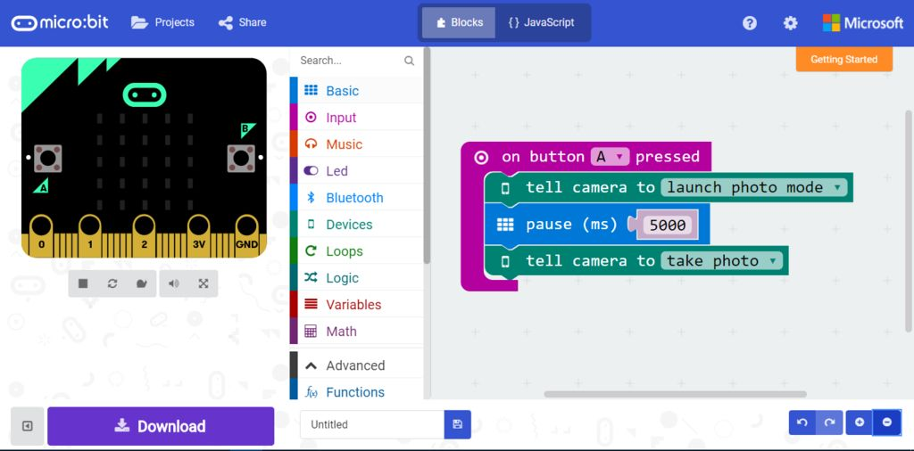
Remote Selfies
https://www.instructables.com/id/Microbit-Selfie-Remote/

Slide 34
Unboxing & Setup (10 min)

Slide 35
Log in to Laptop
Turn on Laptop
Login with username and password provided

Slide 36
Unboxing
Open Box
Pull out micro:bit
Pull out micro USB cable (under cardboard)
Connect via USB cable
Set up batteries (for later)

Slide 37
Web Site
Google micro:bit
Open the main web site
Click “Get Started”
Click “Get Coding”
https://makecode.microbit.org

Slide 38
Android Phone (optional)
Need internet/data connection
Go to Play Store
Search micro:bit
Install Official App
We’ll do more with this later

Slide 39
How To Program (10 min)

Slide 40
Giving Instructions
We write the recipes that will control the device
We can create events
Repeat events
React to events
Write with blocks – or with code

Slide 41
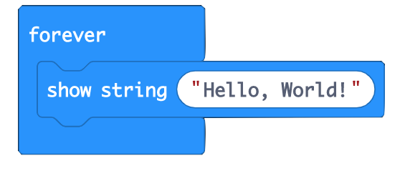
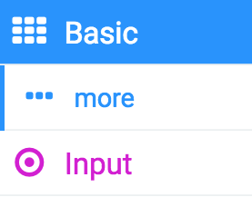
Writing with Blocks
Block Color Indicates Palette
Notes:
Environment: Palette, Color & Icon coded; Most used features are prominent, others are on “…more” menu.
Simulator
Block area

Slide 42
Every App is a Project
Create a new project
Set up the instructions
Save the project
Download it to the micro:bit
Share projects
Steal projects (borrow and customize!)

Slide 43
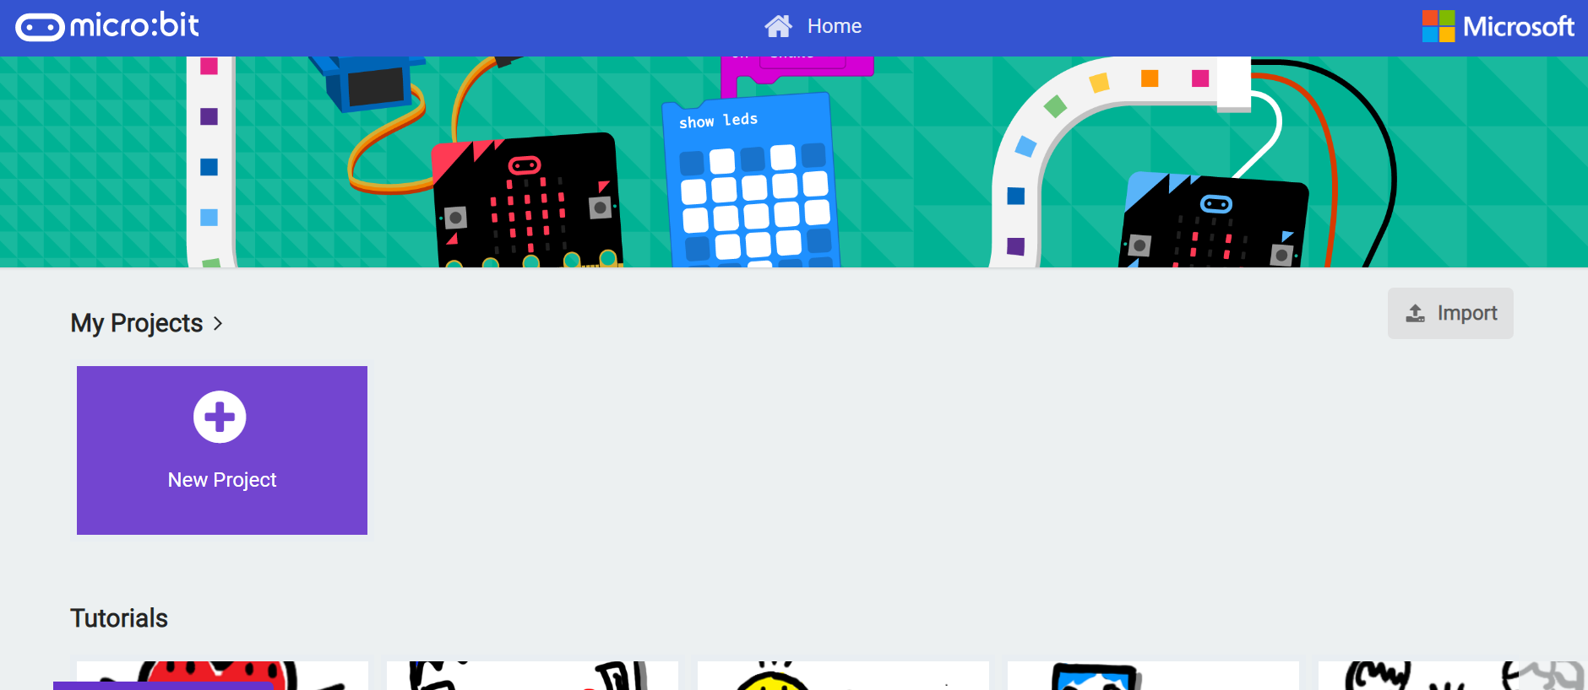
The MakeCode Environment
https://makecode.microbit.org/

Slide 44
Hands On: Animations (10 minutes)

Slide 45
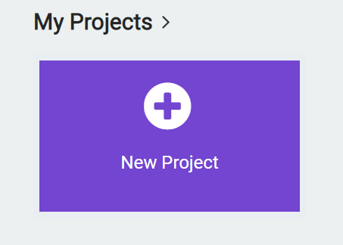
Flashing Heart Project
Guide: https://microbit.org/en/2017-03-07-flashing-heart/
Goto https://makecode.microbit.org/#
New Project

Slide 46
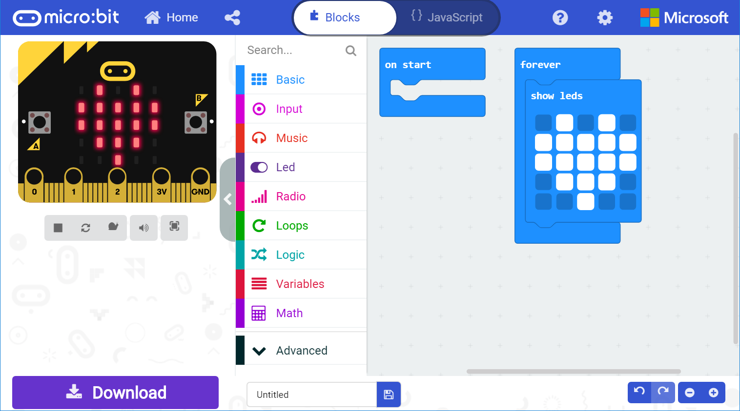
Flashing Heart Project
From basic, drag ‘show leds’ to ‘forever’
Draw heart, type name, click download

Slide 47
Flashing Heart Project
Navigate to “This PC”
Find the D: Microbit drive
Click save.
Edit, add more images & repeat

Slide 48
Result

Slide 49
Hands On: Rock, Paper, Scissors (20 minutes)

Slide 50
Game Project
Guide: https://makecode.microbit.org/projects/rock-paper-scissors
Goto https://makecode.microbit.org/#
New Project
Name it

Slide 51
Colors help find blocks ☺
On shake
Set RandomNumber to pick random 0 to 2
If RandomNumber = 0 then
Show leds Rock
Else if RandomNumber = 1 then
Show leds Paper
Else
Show leds Scissors

Slide 52
Play Rock, Paper, Scissors
When you shake the micro:bit, it picks a random number from 1 to 3 displays either rock, paper, or scissors

Slide 53
Break (10 min)

Slide 54
Questions?
Any issues?
Need any help trouble-shooting?

Slide 55
Controlling an Andriod Phone (20 minutes)

Slide 56
Requirements
Android Phone
Micro:bit app on the phone
Battery pack & micro:bit
Open App on Phone
Have micro:bit powered on with batteries
We’ll demonstrate first…

Slide 57
Remote Selfies
https://www.instructables.com/id/Microbit-Selfie-Remote/
Open Android App

Slide 58
Remote Selfies
https://www.instructables.com/id/Microbit-Selfie-Remote/
Pair micro:bit and phone

Slide 59
Remote Selfies
https://www.instructables.com/id/Microbit-Selfie-Remote/

Slide 60
Pairing

Slide 61
Hands On: Remote Selfie (30 minutes)

Slide 62
Your Turn
First, pair your devices (or plan a new app)
Create a project
Name your project
Implement your instructions
Download and test your app

Slide 63
Remote Selfies
https://www.instructables.com/id/Microbit-Selfie-Remote/
Open Android App

Slide 64
Remote Selfies
https://www.instructables.com/id/Microbit-Selfie-Remote/
Pair micro:bit and phone

Slide 65
Remote Selfies
https://www.instructables.com/id/Microbit-Selfie-Remote/

Slide 66
Testing & Sharing Apps (20 minutes)

Slide 67
Share Your Work
Show the group your projects
Questions?
Ideas to explore
Google more options & accessories
Brainstorm ideas
Watering plants, temperature sent to phone or displayed, gesture-based results, send text messages, more

Slide 68
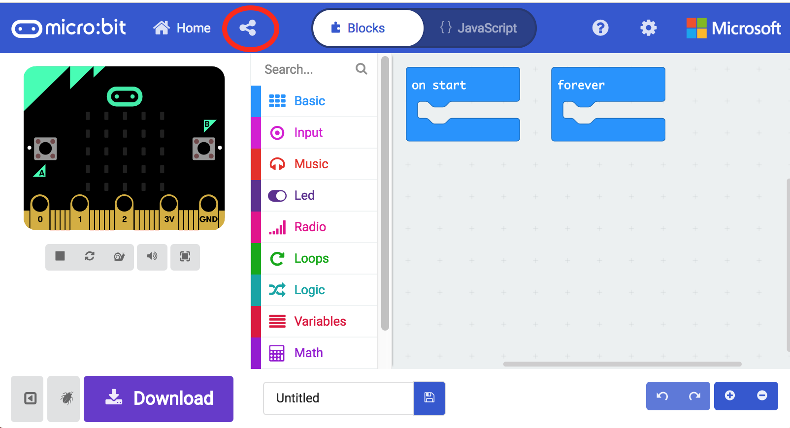
Sharing via URL, or publish

Slide 69
Wrapping Up / Discussion (10 min)

Slide 70

Wrapup
Discussion
Comments
Contact Us:
Dr. Carol Spradling c_sprad@nwmissouri.edu
Dr. Denise Case dcase@nwmissouri.edu

Slide 71
NCWIT micro:bit Workshop
Dr. Carol Spradling
Dr. Denise Case
Saturday, September 21, 2019
9:30 am – 12:30 pm

